Slide 1
SAP Gateway
Day 1
<Trainer>
Capgemini, India

Slide 2
SAP Gateway Day 2 - Agenda
Structure of an Odata service
Introduction about SAP Gateway
SAP Gateway Overview and Architecture
SAP Gateway – Deployment options
REST Architecture

Slide 3
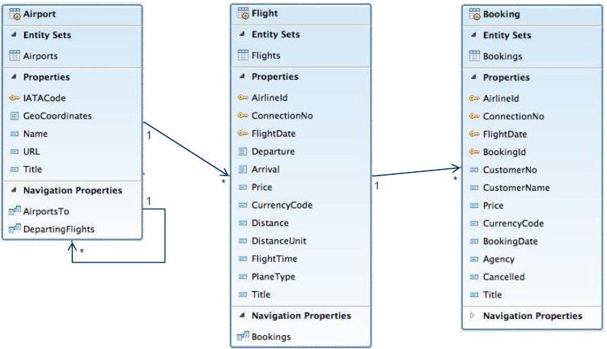
OData Service – Data Model & Structure
An Entity Data Model (EDM) is the starting point for building an OData service. An EDM describes
both the data structures and their inter-relationship used in a business scenario.

Slide 4
Definitions
An Entity type can be considered as data type that contains details of specific type of data.
For example: Customer, Supplier, Sales Order, Employee etc.
An Entity set is nothing but a collection of Entity type.
Entity Key is used to uniquely identify an Entity Type.
For example: Employee number , Sales Order number
Association is simply relation ship between two or more Entity types
For example: Products to its Manufacturer
An entity set Product can be associated with an entity set Manufacturer in an OData metadata.
Navigation Property is a property set on an entity type to understand the associations of the entity type.

Slide 5
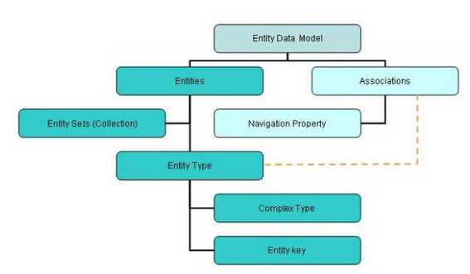
Metadata of OData
The metadata of OData message can be summarized as follows.
Refer to this blog: http://www.odata.org/

Slide 6
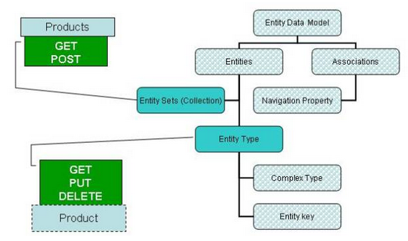
Possibility operations
We can do a GET and POST request on an Entity Set while GET, PUT and DELETE can be done on an Entity.

Slide 7
Service Operations
Service Operations:
- GetEntity
we can refer to as work area in ABAP
- GetEntitySet
we can refer to as internal table in ABAP
- Create
We can create only single record at once.
- Update
We can single only record at once.
- Delete
We can delete only single record at once.

Slide 8
Queries to manipulate the data
$format : This query allows us to change the format of data.
URI: http://services.odata.org/OData/OData.svc/Suppliers?$format=json
$top : This query helps to limit the data returned by the service.
URI: http://services.odata.org/OData/OData.svc/Categories?$top=1
$Skip :This can be treated as opposite to $top.
URI: http://services.odata.org/OData/OData.svc/Products?$skip=2
$inlinecount: This will return the total number of records as part of response payload.
URI: http://services.odata.org/OData/OData.svc/Suppliers?$inlinecount=allpages
$orderby :It is used to sort the records returned by service.
URI: http://services.odata.org/OData/OData.svc/Products?$orderby=Price desc

Slide 9
Queries to manipulate the data
$expand :This we found as very helpful query to reduce the number of calls we need to make to access a particular set of data. Say, if you want to return all the products along with their category, use the URL provided in the example
URI: http://services.odata.org/OData/OData.svc/Products?$expand=Category
$filter : This can be compared to ‘where’ query in SQL. Lets say we want to get all the products with greater than 3, below is the URI
URI: http://services.odata.org/OData/OData.svc/Products?$filter=Rating gt 3
$select :As is any SQL query, this query option can be used to select specific or all fields of an Entity set or Entity. A simple example, lets say the requirement for which is for us to return the fields rating and Price of a Product with ID = 3
URI: http://services.odata.org/OData/OData.svc/Products(3)?$select=Rating,Price

Slide 10
How to play with URI’s
More examples:
Get me the three of the best rated products
URI: http://services.odata.org/OData/OData.svc/Products?$top=3&$orderby=Rating desc
Now get me the next three best rated products.
URI: http://services.odata.org/OData/OData.svc/Products?$top=3&$skip=3&$orderby=Rating desc
Get me the count of Products with the Price greater than or equal to 20?
URI: http://services.odata.org/OData/OData.svc/Products?$inlinecount=allpages&$filter=Price ge 20

Slide 11
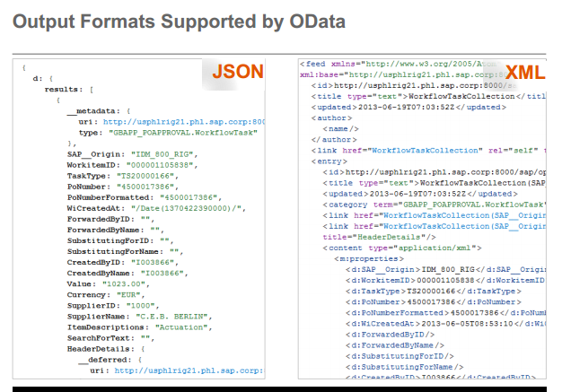
Why OData
Why OData instead of REST ?
We have seen how OData provides you with a consistent uniform standard way of describing the data and the data model. That precisely gives it an edge over REST.

Slide 12
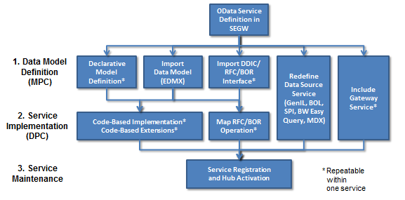
Gateway Service Builder Tool
Gateway Service Builder (transaction "SEGW") is available as of Release 2.0 Support Package 4/5 and it greatly accelerates the OData service development process. In many cases you don't even need to write a single line of ABAP code - unless of course you prefer to do so. It is no longer mandatory that you have deep ABAP OO skills.
In Service Builder we need to do follow below three steps to build an OData service:
Define or import the data model
Implement or generate the runtime logic for the service operations
Activate and run the service
The picture shows the various options
that are covered in SEGW:

Slide 13
SEGW
Need to understand below terms in SEGW transaction
- Entity Type
- Entity Set
- Association
- Navigation
- Referential Constraints
- MPC( Model Provider Class )
- DPC( Data Provider Class )

